Slide 1

BLACK FRIDAY PREDICTION
BLACK FRIDAY SALE OPEN
Prepared by:-Vivek Kumar Internship33

Slide 2
CONTENT
Overview.
Problem Statement.
What is Black Friday Sale ?
Importance of Black Friday Sale prediction.
Exploratory data analysis.
Visualizations.
Analysis.
Conclusion

Slide 3
PROBLEM STATEMENT
A retail company “ABC Private Limited” wants to understand the customer purchase behaviour (specifically, purchase amount) against various products of different categories. They have shared purchase summary of various customers for selected high volume products from last month. The data set also contains customer demographics (age, gender, marital status, city_type, stay_in_current_city), product details (product_id and product category) and Total purchase_amount from last month. Now, they want to build a model to predict the purchase amount of customer against various products which will help them to create personalized offer for customers against different products.
•Data
• Variable Definition • User_ID User ID • Product_ID Product ID • Gender Sex of User • Age Age in bins • Occupation Occupation (Masked) • City_Category Category of the City (A,B,C) • Stay_In_Current_City_Years Number of years stay in current city • Marital_Status Marital Status • Product_Category_1 Product Category (Masked) • Product_Category_2 Product may belongs to other category also (Masked) • Product_Category_3 Product may belongs to other category also (Masked) • Purchase Purchase Amount (Target Variable)

Slide 4
WHAT IS BLACK FRIDAY SALE?
The day following Thanksgiving—commonly referred to as Black Friday—has become one of the busiest shopping days of the year in the United States. National chain stores traditionally offer limited money-saving specials on a wide variety of goods in an effort to lure shoppers into stores while offering similar deals online.
It is believed by many that the term Black Friday derives from the concept that businesses operate at a financial loss, or are “in the red,” until the day after Thanksgiving, when massive sales finally allow them to turn a profit, or put them “in the black.” However, this is untrue.

Slide 5
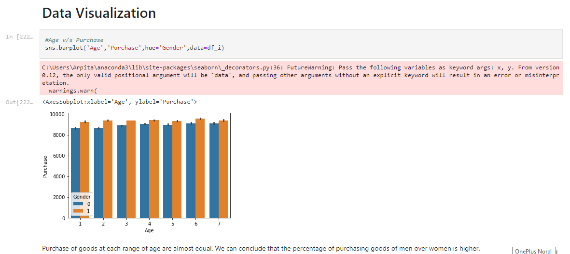
DATA VISUALISATION
Purchase of goods at each range of age are almost equal. We can conclude that the percentage of purchasing goods of men over women is higher.
Age v/s Purchase:

Slide 6
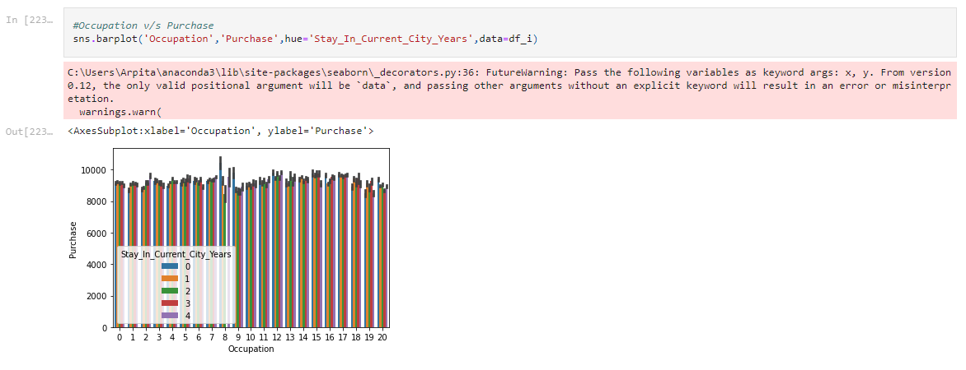
DATA VISUALISATION
All the occupation contributes almost same in purchasing rates and it won't affect alot that how many years you live in a city.
Occupation v/s Purchase:

Slide 7
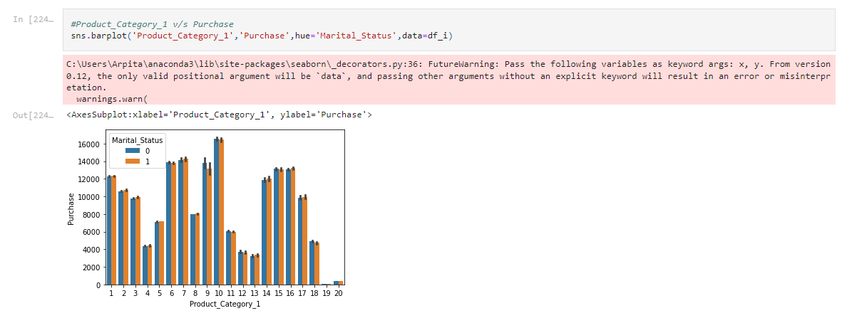
DATA VISUALISATION
Product category_1 v/s Purchase:

Slide 8
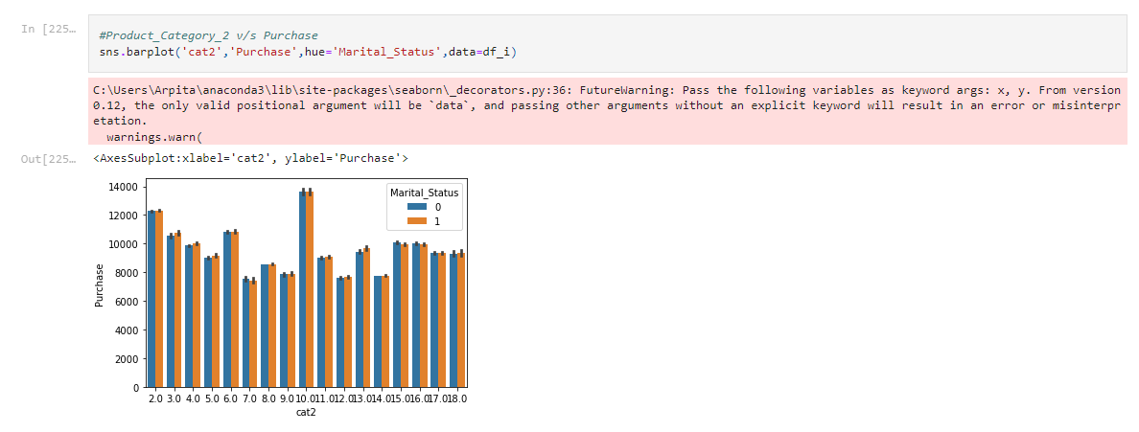
DATA VISUALISATION
Product category_2 v/s Purchase:

Slide 9
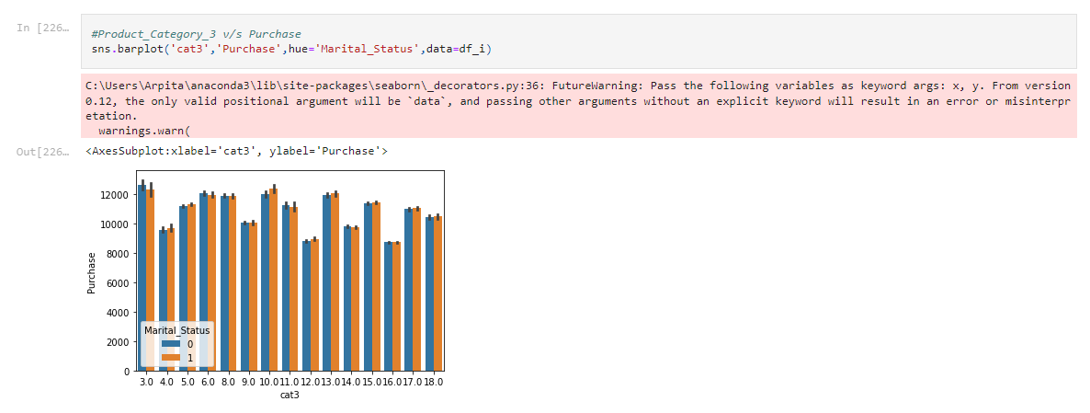
DATA VISUALISATION
One thing we can clearly conclude is that there is no such variation in the percentage of the purchasing whether the person is married or not. product category3 is much morepurchased by people than product category2 and product category1
Product category_3 v/s Purchase:

Slide 10
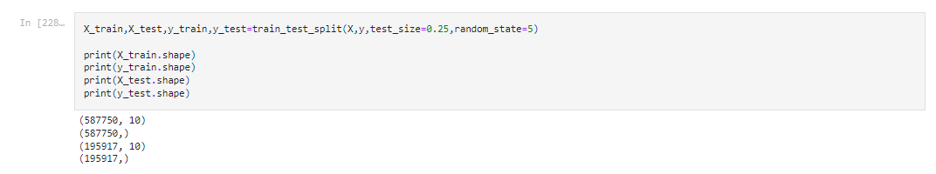
Splitting the dataset into the Training set and Test set

Slide 11
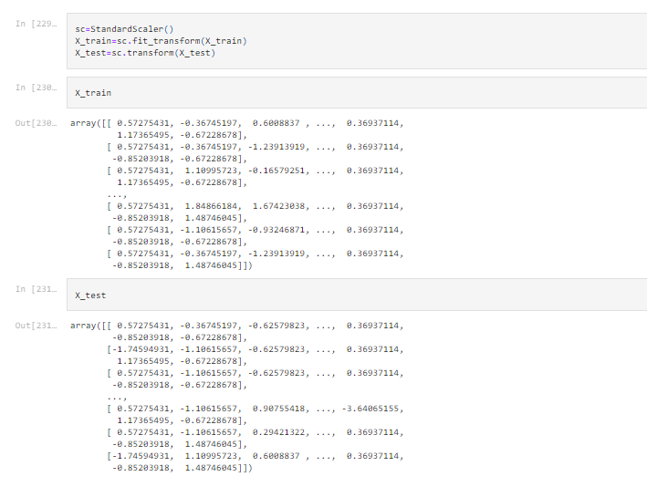
Feature Scaling So that data in all the columns are to the same scale:

Slide 12
CONCLUSION
Now we have features for both training and testing.
The data can now be converted to a dataframe, if necessary
It can be fed to a machine learning model.

Slide 13
SCOPE:
The future of Black Friday will rely on customer experience and the offerings driving demand. People need to feel like the While more bargain hunters opened their wallets for Black Friday this year, on average they spent a little less than in last year. Black Friday sales are still increasing, which is promising for retail. Effectively utilising this strong online trend is key for retailers to ensure Black Friday is still a profitable event. But a slow down in the intent of customers to buy things may indicate that interest is waning and expectation is increasing.

Slide 14
THANK YOU!!

